Slide 1
CSCE430/830 Computer Architecture
Disk Storage Systems
Lecturer: Prof. Hong Jiang
Courtesy of Yifeng Zhu (U. Maine)
Fall, 2006
Portions of these slides are derived from:
Dave Patterson © UCB

Slide 2
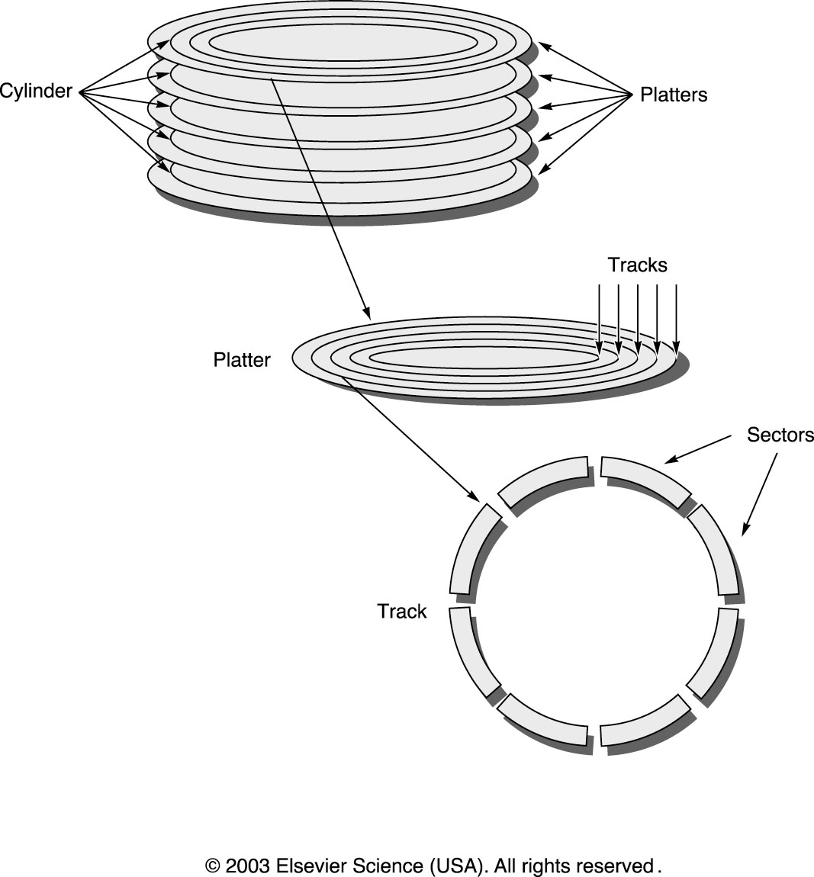
Disk Device Terminology

Slide 3
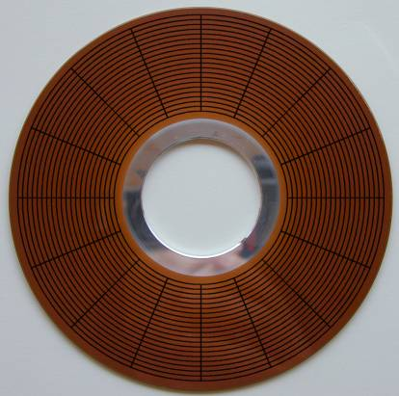
Disk Overview: Data Layout
tract
sector
heads
cylinder
platters
http://www.pcguide.com

Slide 4
Disk Device Performance
Outer
Track
Inner
Track
Sector
Head
Arm
Controller
Spindle
Platter
Actuator
Disk Latency = Seek Time + Rotation Time + Transfer Time + Controller Overhead
Seek Time? Depends no. tracks the arm moves and seek speed of disk
Rotation Time? depends on rotational speed and how far the sector is from the head
Transfer Time? depends on data rate (bandwidth) of disk (bit density) and the size of request

Slide 5
Disk Time Example
Disk parameters:
  Transfer size is 8K bytes
  Advertised average seek time is 12 ms
  Disk spins at 7200 RPM
  Transfer rate is 4 MB/sec
Controller overhead is 2 ms
Assume that disk is idle so no queuing delay
What is average disk access time for a sector?

Slide 6
Disk Time Example
Disk parameters:
  Transfer size is 8K bytes
  Advertised average seek time is 12 ms
  Disk spins at 7200 RPM
  Transfer rate is 4 MB/sec
Controller overhead is 2 ms
Assume that disk is idle so no queuing delay
What is average disk access time for a sector?
  Avg seek + avg rotational delay + transfer time + controller overhead
  12 ms + 0.5/(7200 RPM/60) + 8 KB/4 MB/s + 2 ms
  12 + 4.15 + 2 + 2 = 20 ms
Advertised seek time assumes no locality: typically 1/4 to 1/3 advertised seek time: 12 ms ⇒ 3-4 ms

Slide 7
The following shows two potential ways of numbering the sectors of data on a disk (only two tracks are shown and each track has eight sectors). Assuming that typical reads are contiguous (e.g., all 16 sectors are read in order), which way of numbering the sectors will be likely to result in higher performance? Why?
Cylinder and Head Skew
0
0
1
1
7
7
8
14
9
15
15
13
10
2
2
14
8
6
6
12
11
9
13
11
10
12
3
3
5
5
4
4

Slide 8
Disk Scheduling
Seek time is a dominant factor of total disk I/O time
Let operating system or disk controller choose which request
to serve next depending on the head’s current position and requested block’s position on disk (disk scheduling)
Note that disk scheduling ≠ CPU scheduling
  a mechanical device – hard to determine (accurate) access times
  disk accesses can/should not be preempted – run until it finishes
  disk I/O often the main performance bottleneck
General goals
  short response time
  high overall throughput
  fairness (equal probability for all blocks to be accessed in the same time)
Tradeoff: seek and rotational delay vs. maximum response time

Slide 9
Disk Scheduling
Several traditional algorithms
  First-Come-First-Serve (FCFS)
  Shortest Seek Time First (SSTF)
  SCAN (and variations)
  Look (and variations)
  …
A LOT of different algorithms exist depending on expected access pattern

Slide 10
First–Come–First–Serve (FCFS)
FCFS serves the first arriving request first:
Long seeks
“Short” average response time
incoming requests (in order of arrival, denoted by cylinder number):
12
14
2
7
21
8
24
cylinder number
scheduling
queue
1
5
10
15
20
25
12
14
2
7
21
8
24
time

Slide 11
SCAN
SCAN (elevator) moves head edge to edge and serves requests on the way:
bi-directional
compromise between response time and seek time optimizations
several optimizations: C-SCAN, LOOK, C-LOOK, …
incoming requests (in order of arrival):
12
14
2
7
21
8
24
12
14
2
7
21
8
24
cylinder number
1
5
10
15
20
25
scheduling
queue
time

Slide 12
SCAN vs. FCFS
cylinder number
1
5
10
15
20
25
Disk scheduling makes a difference!
In this case, we see that SCAN requires much less head movement compared to FCFS
time
time

Slide 13


Modern Disk Scheduling
Disk used to be simple devices and disk scheduling used to be performed by OS (file system or device driver) only…
… but, new disks are more complex
  hide their true layout, e.g.,
    only logical block numbers
    different number of surfaces, cylinders, sectors, etc.
OS view
real view

Slide 14
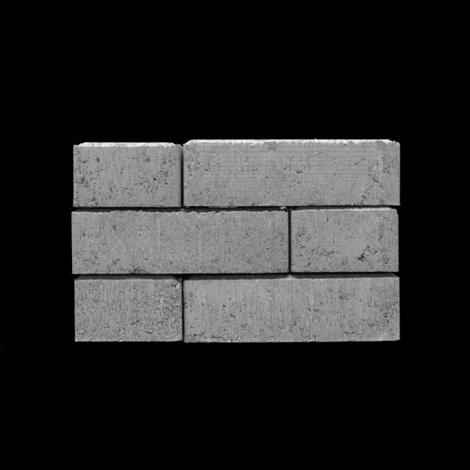
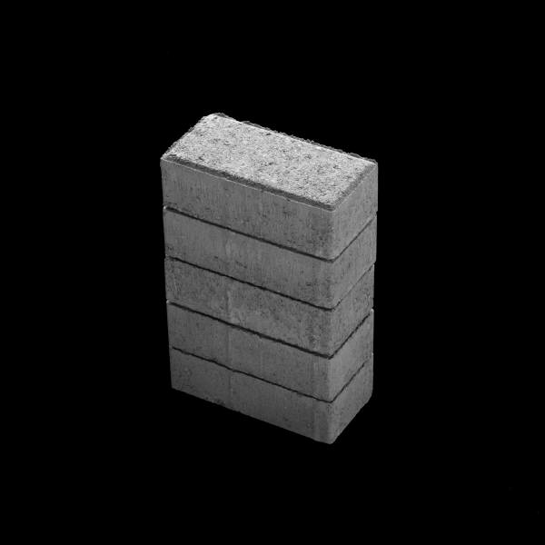

Modern Disk Scheduling
Disk used to be simple devices and disk scheduling used to be performed by OS (file system or device driver) only…
… but, new disks are more complex
  hide their true layout
  transparently move blocks to spare cylinders
    e.g., due to bad disk blocks
OS view
real view

Slide 15
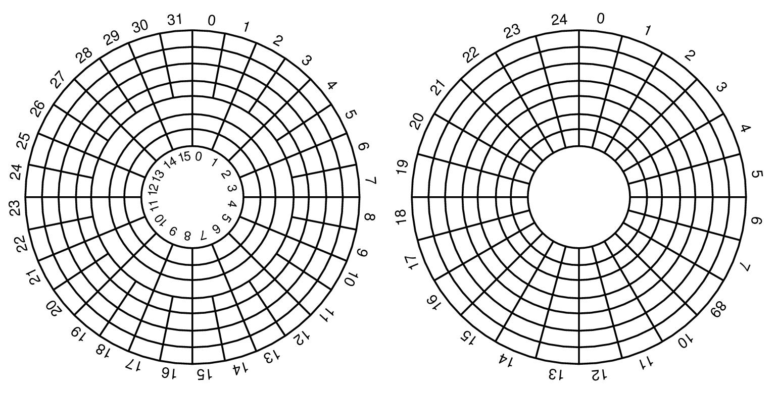
Modern Disk Scheduling
Disk used to be simple devices and disk scheduling used to be performed by OS (file system or device driver) only…
… but, new disks are more complex
  hide their true layout
  transparently move blocks to spare cylinders
  have different zones
OS view
real view
Constant angular velocity (CAV) disks
  constant rotation speed
  equal amount of data in each track
  thus, constant
  transfer time
Zoned CAV disks
  constant rotation speed
  zones are ranges of tracks
  typical few zones
  the different zones have different amount of data, i.e., more better on outer tracks
  thus, variable transfer time
NB! illustration of transfer time, not rotation speed

Slide 16
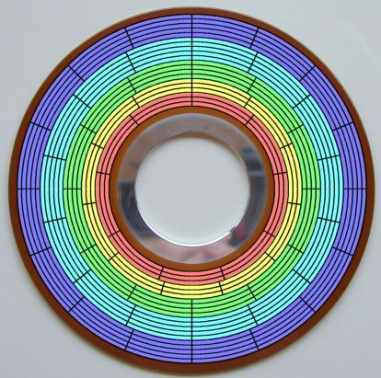
Zoned Bit Recording
To eliminate this wasted space, modern hard disks employ a technique called zoned bit recording (ZBR).
tracks are grouped into zones based on their distance from the center of the disk, and each zone is assigned a number of sectors per track.

Slide 17
Modern Disk Scheduling
Disk used to be simple devices and disk scheduling used to be performed by OS (file system or device driver) only…
… but, new disks are more complex
  hide their true layout
  transparently move blocks to spare cylinders
  have different zones
  head accelerates – most algorithms assume linear movement overhead
Time
~ 10x - 20x
x
Cylinders Traveled
1
N

Slide 18

Modern Disk Scheduling
Disk used to be simple devices and disk scheduling used to be performed by OS (file system or device driver) only…
… but, new disks are more complex
  hide their true layout
  transparently move blocks to spare cylinders
  have different zones
  head accelerates – most algorithms assume linear movement overhead
  on device buffer caches may use read-ahead prefetching
disk
buffer
disk

Slide 19
Modern Disk Scheduling
Disk used to be simple devices and disk scheduling used to be performed by OS (file system or device driver) only…
… but, new disks are more complex
  hide their true layout
  transparently move blocks to spare cylinders
  have different zones
  head accelerates – most algorithms assume linear movement overhead
  on device buffer caches may use read-ahead prefetching
  are “smart” with build in low-level scheduler (usually SCAN-derivate)
  we cannot fully control the device (black box)
OS could (should?) focus on high level scheduling only
Current research look at on-device programmable processors

